Slide 1
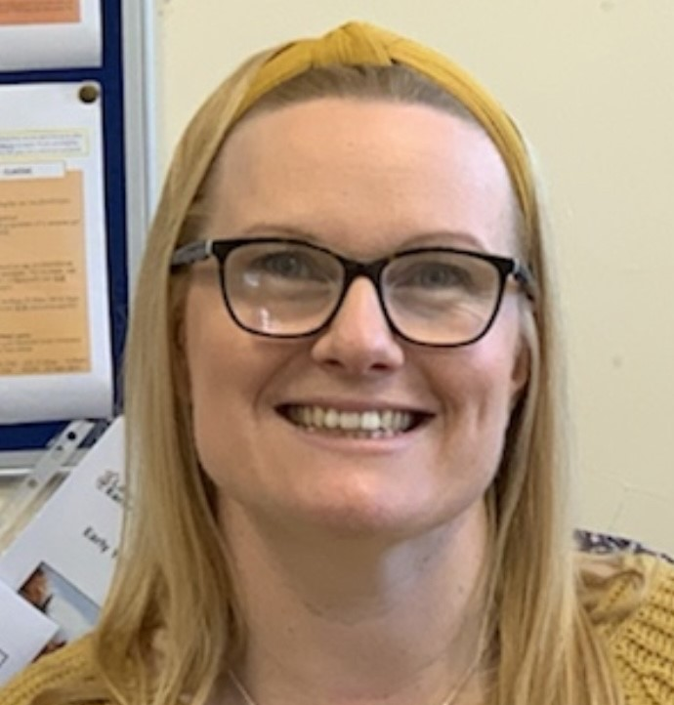
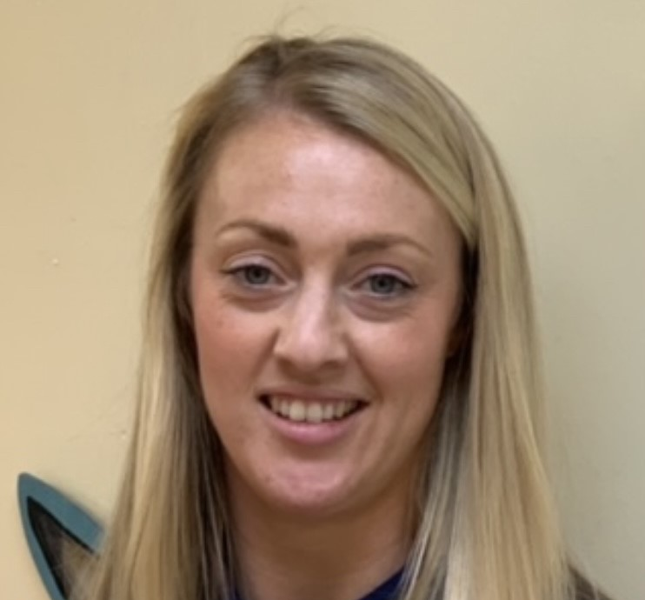
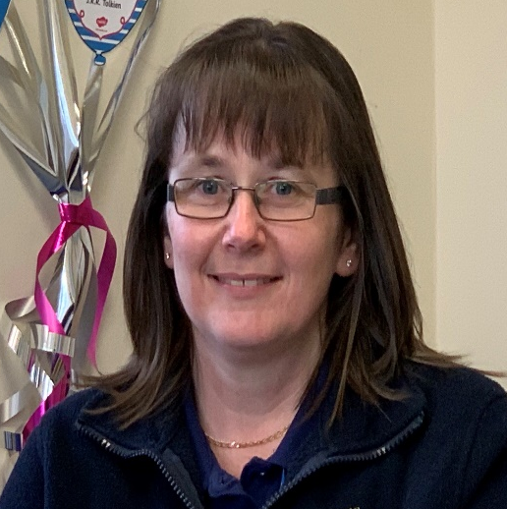
Meet the team
BABY ROOM
My name is Suzanne. I am the Early Years Leader. I manage the Nursery and am one of the Reception teachers. I have worked in Early Years for 18 years and I am passionate about helping our youngest children to grow. I may not always be visible to you in the setting due to my teaching role, but I am always available to answer any questions you may have.
My name is Nichola and I am the room leader and Deputy of the Nursery. I joined the Nursery in 2011
Looking after young children has been a pleasure since I started my journey in 2008.
I hope to continue this fulfilling journey for many more years to come and look forward to getting to know your child.
My name is Michelle and I am the deputy room leader.
I have worked in the baby room since we opened in 2019. I have worked in childcare full time since 1996. I have had the pleasure of gaining many years experience caring for children and babies in a career I am passionate about.
My name is Bev. I joined Acorns Nursery originally as a volunteer. I have completed my Early Years training and am now delighted to be part of the Baby Room team. I look forward to continuing my role and supporting your lovely children. I am passionate about helping your child to grow.

