Slide 1
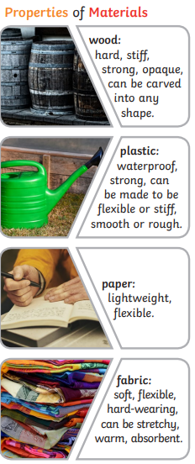
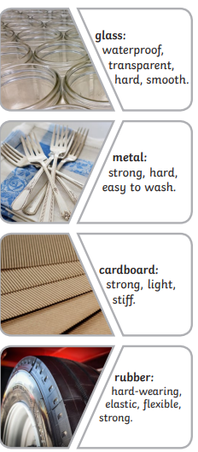
Science – Materials
Key Vocabulary
Materials | what objects are made from
Properties | This is what a material is like and how it behaves
Opaque | Cannot be seen through
Transparent | Can be seen through
Rigid | Unable to be bent or forced out of shape.
Flexible | Able to bend
Rough | Uneven surface
Smooth | Even surface
Brittle | Hard but may break easily
Hard | Not easily broken or pierced
Waterproof | Something that keeps water out is waterproof.
Absorbent | Something that lets water in.
Man-made | Made by humans
Natural | comes from nature
Key Knowledge

Slide 2
