Slide 1
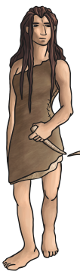
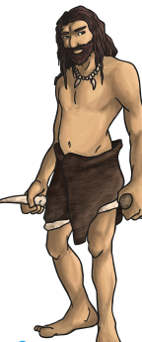

History:- The Stone Age
Key Vocabulary
Pre-History | The time before events were written down.
Chronology | The arrangements of dates and events in the order they occurred.
Archaeologist | Historians that find out about the past by looking at what people left behind by digging up objects.
Hunter Gatherers | Someone who hunts animals and gathers wild food to eat.
Hammer stone | One of the earliest stone age tools.
Hand axe | A prehistoric stone tool used for cutting and scavenging.
Flint | A hard stone that can produce a spark when struck by another stone
What was the Stone Age?
The Stone Age is a period of time when humans used stone to make tools with a sharp edge or point.
What did the Stone Age people have to do?
hunt and gather food
find water and shelter
skin animals and make clothes
collect firewood for making fires to cook on, keep warm and warn off wild animals
make tools and weapons

Slide 2
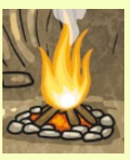
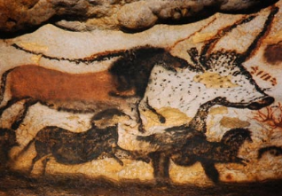
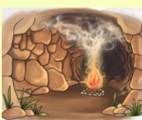
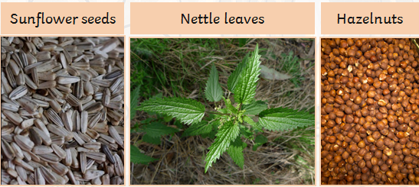
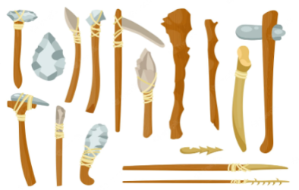

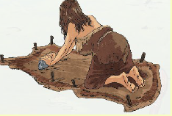
Fire
They would light fires
inside their caves or around their settlements to cook food, keep warm and ward off wild animals.
Hunter Gathers
Animals were the main source of food. Horse, deer, hares, seabirds, fish were all eaten. Every part of the animal was used including bone marrow.
They would gather plants, seeds, berries and nuts from the local area to eat.
Sometimes they would live in natural caves in the rocks.
Caves
Cave Paintings
Cave drawings were made
using charcoal, ground down coloured rock and animal fat.
Tools
Tools would make out of sharp stones, wood and bone.
Animal Skins
Animal fur and skin would be used to make clothing. They would use
simple tools to scrub the animal fur and skin.
Wooden Houses
Some houses had a wooden frame
secured with rocks and covered with animal skins.

