Slide 1
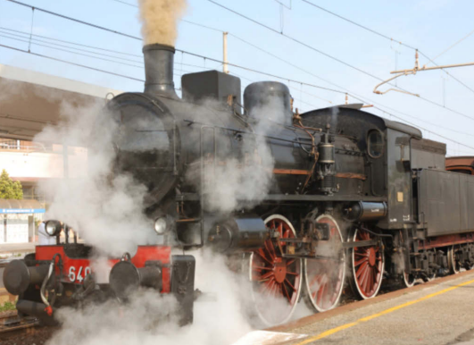
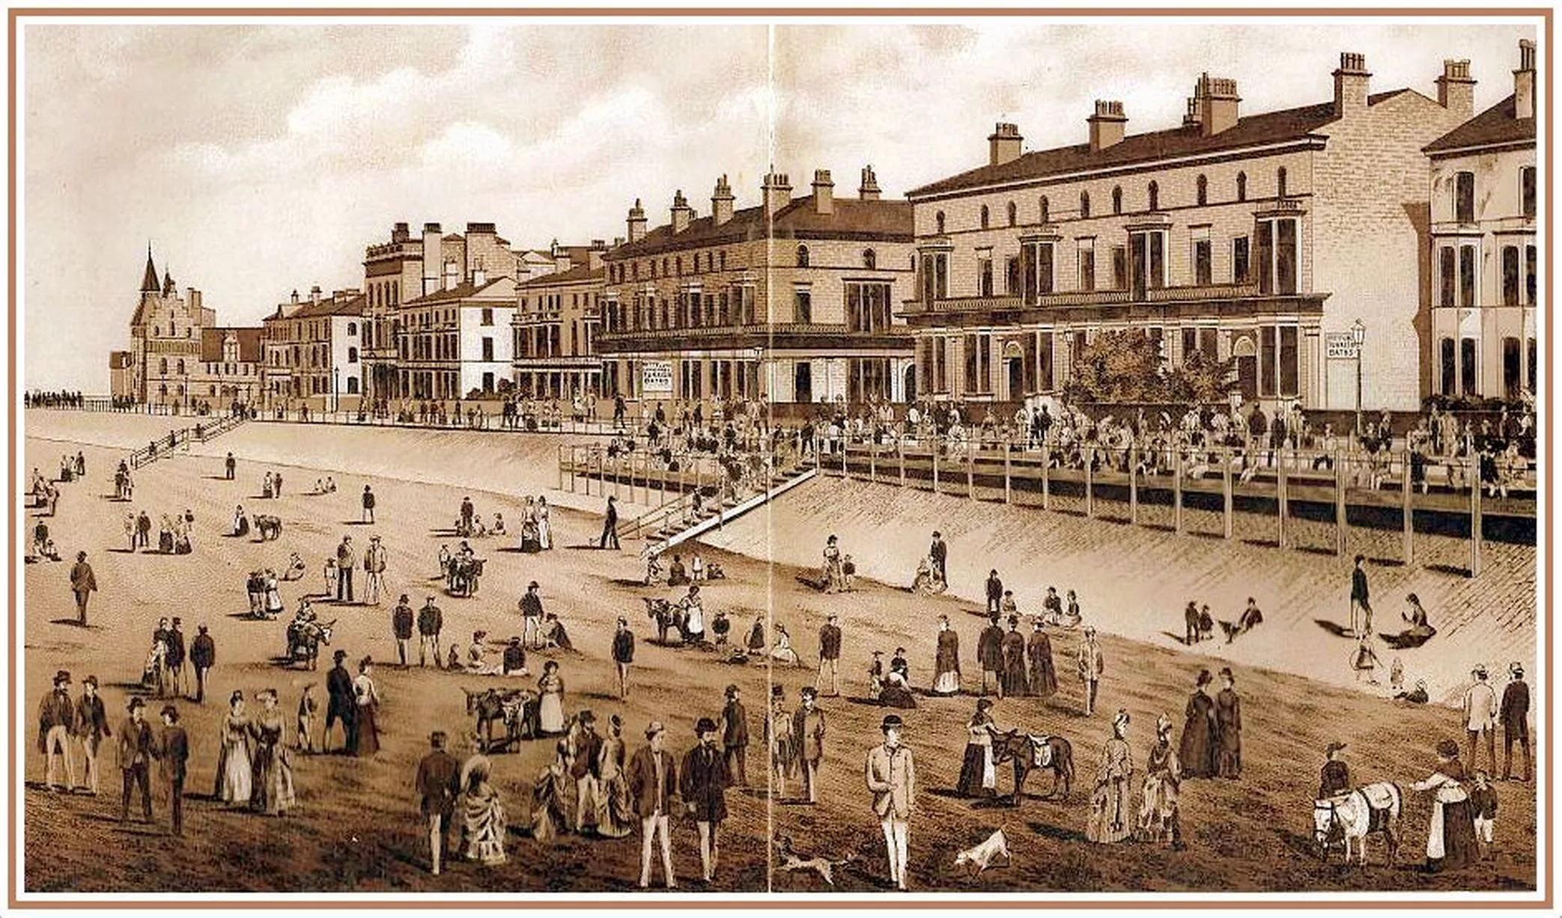
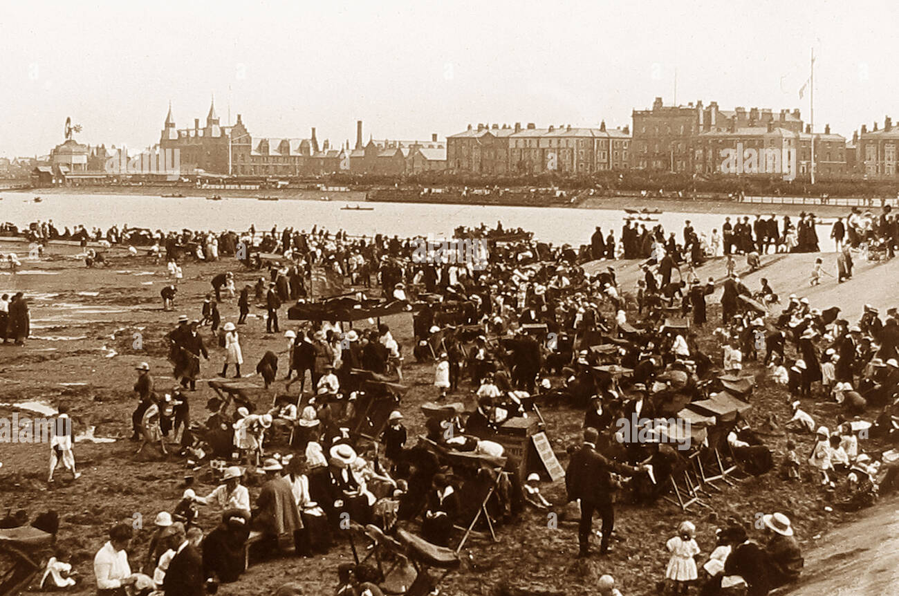
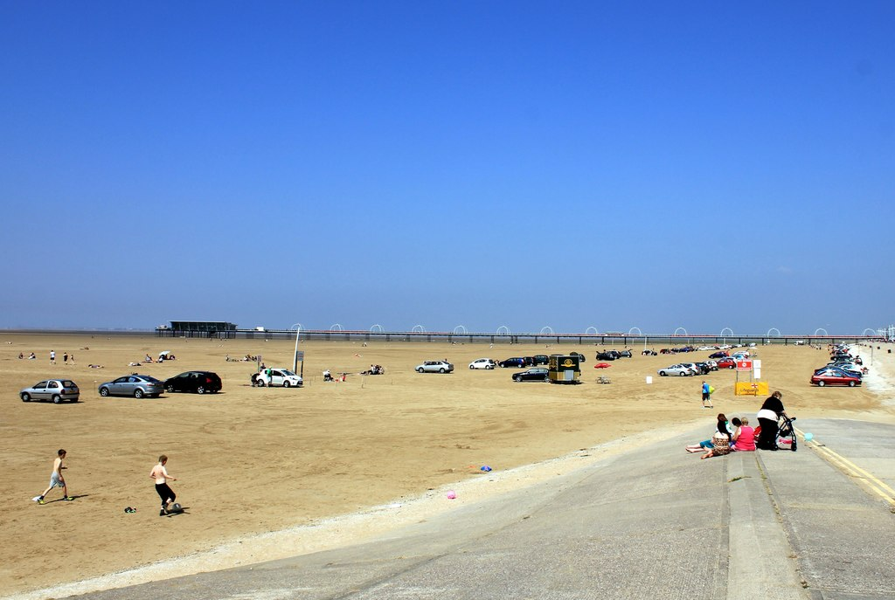
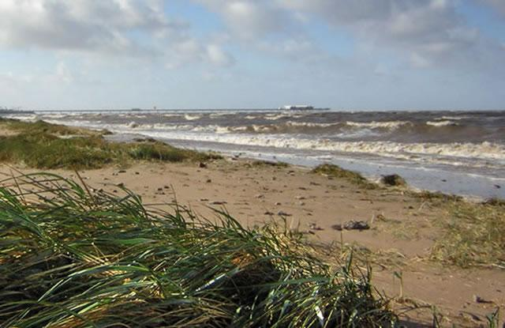
History: Seaside
Key Vocabulary
Seaside | A place by the sea, especially a beach area or holiday resort.
Coast | The part of the land that is near the sea
Promenade | A paved public walk along the seafront.
Pier | A wooden structure on pillars that goes from land out over water.
Souvenir | Something that is kept as a reminder of a place visited.
Bathing Machine | Bathing machines were used a long time ago so people could change in private before getting into the sea
Key Knowledge
People have been going on seaside holidays for over a hundred years.
❖ During the 19th century, the development of railways allowed more people to visit different seaside resorts. They were cheap and fast.
❖ Punch and Judy is a funny puppet show, common at the seaside in the Victorian times.
❖ Bucket and spades would be very heavy to carry. They were made from metal, tin and wood. Donkey rides, entertainment and carousels on the pier are still popular today.
❖ Bathing machines were invented for the upper class so they could get changed into their bathing costumes in privacy.
❖ Victorians believed drinking sea water and breathing in fresh, sea air would keep you healthy.
❖ Piers were created for the upper class so they could be near the sea without getting wet
Timeline of Southport Beach
1880
1910
2000
2024

